Slide 1
SMART STORAGE AND WAREHOUSING SYSTEM FOR AGRICULTURAL PRODUCTS
BY
ABISHEK S
953223105301

Slide 2
INTRODUCTION:
Agriculture is a Backbone of every country. Without Agricultural products No Living beings can surveyed.
This project introduces a Smart Storage and Warehousing System for Agricultural Products using the ESP32-CAM module , ESP32 Microcontroller, QR Label and LCD Display.
Each storage bag is labeled with a QR code containing pre-measured data such as Product type, Weight, and Owner Name .
The ESP32-CAM scans the QR code using its onboard camera, decodes the embedded information, and sends it to an LCD display for real-time visualization.
This system streamlines inventory tracking, reduces manual errors, and provides a low-cost, scalable solution for modern agricultural logistics.

Slide 3
NECESSITY OF THE PROJECT:
Save the Post-harvest products from Spoils and damage.
Automation of Inventory Tracking – Reducing Human Error and Saving Time.
Real-Time Data Display – Instantly shows Product Details, which Improves Warehouse
Visibility.
Improved Accuracy – Ensures Precise Identification of Stored Products.
Enhanced Efficiency – Process and Dispatch operations are Speeds Up.
Cost – Effective Solution – Uses Cost Effective Components.

Slide 4
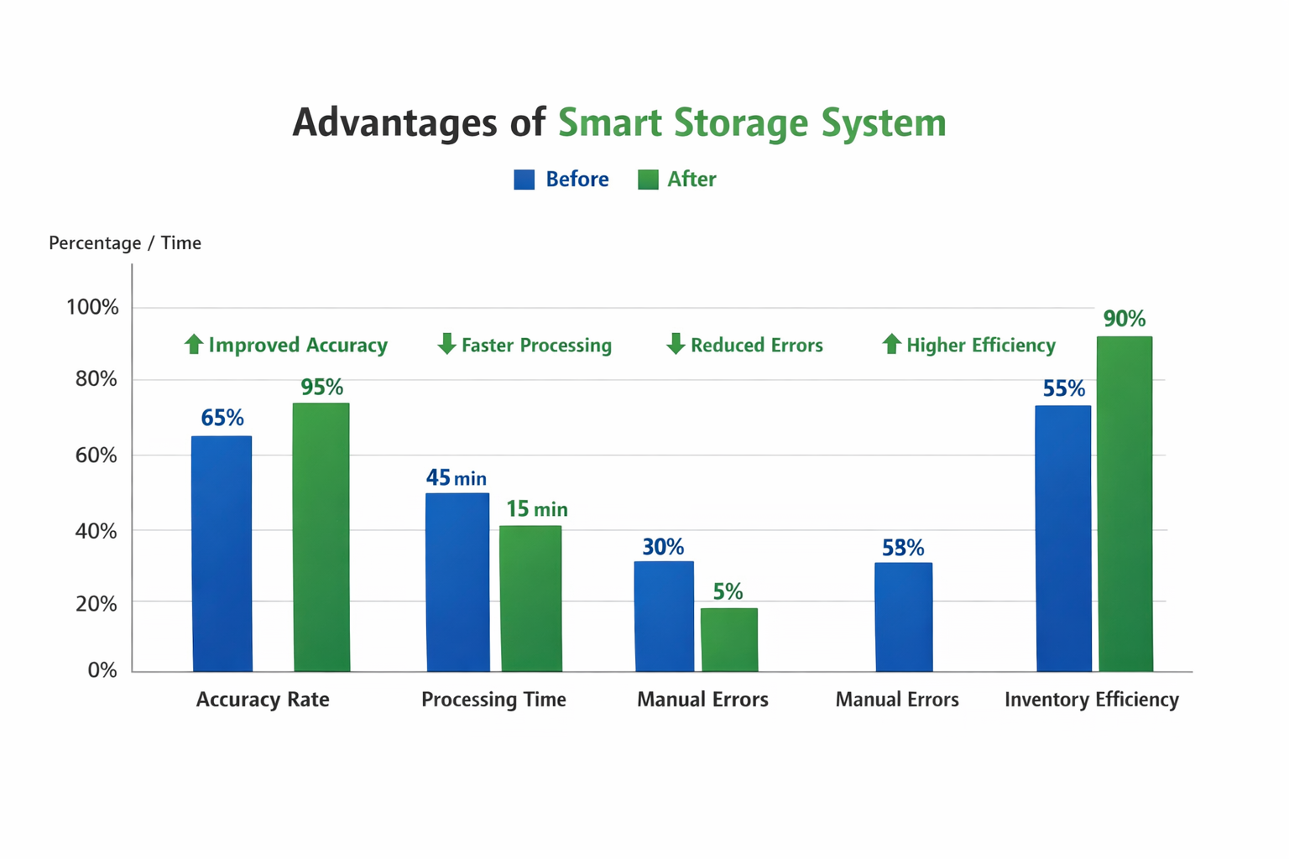
GRAPHICAL REPRESENTATION:

Slide 5
COMPONENETS USED:
ESP32 - CAM MODULE
ESP32 BOARD
QR CODE STICKER
16*2 LCD DISPLAY
CONNECTING JACK WIRES

Slide 6
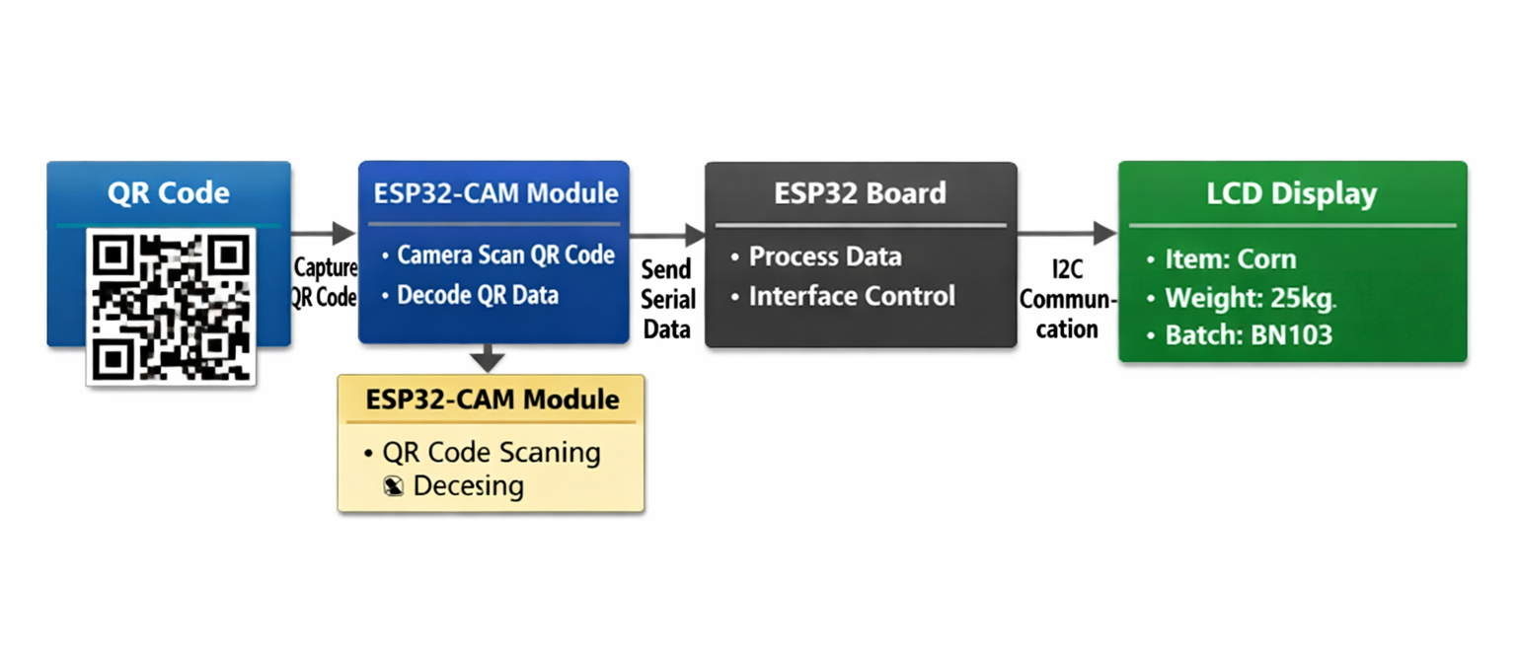
BLOCK DIAGRAM:

Slide 7
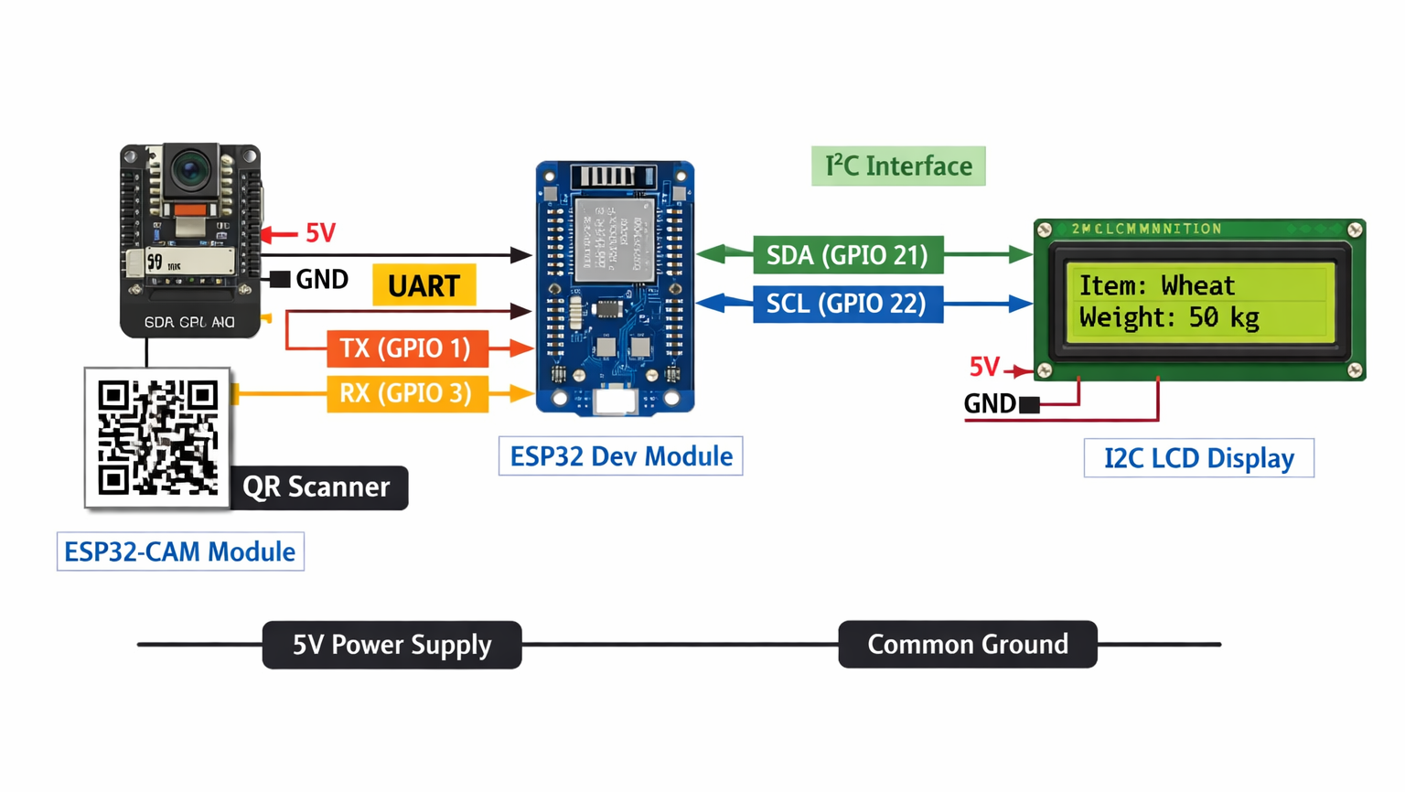
HARDWARE CONNECTION:

Slide 8
CODING:
#include "esp_camera.h"
#include <WiFi.h>
const char* ssid = "YOUR_WIFI_SSID";
const char* password = "YOUR_WIFI_PASSWORD";
#define CAMERA_MODEL_AI_THINKER
#include "camera_pins.h"
void startCameraServer();
void setup() {
Serial.begin(115200);
Serial.setDebugOutput(true);
Serial.println();
WiFi.begin(ssid, password);
WiFi.begin(ssid, password);
while (WiFi.status() != WL_CONNECTED) {
delay(500);
Serial.print(".");
}
Serial.println("");
Serial.println("WiFi connected");
Serial.println("Camera ready! Use 'http://' + IP to connect");
Serial.println(WiFi.localIP());
startCameraServer();
}
void loop() {
}

Slide 9
PROJECT OBJECTIVE :
1. To Automate the Identification and Tracking of Storage Bags.
2. Displaying the Information on a LCD Display.
3. Which Improves Warehouse Efficiency and Reduce Manual Errors.
4. Provide Reliable , Efficient and Low – Cost Solution for Real Time
Monitoring of Post – Harvest Products for Farmers.

Slide 10
APPLICATION :
1. agricultural warehousing
2. library or book storage
3. pharmaceutical storage
4. logistics & packaging units
5. retail inventory systems
6. educational demonstration
7. food supply chain management
8. cost – effective automation

Slide 11
CONCLUSION:
1. The System Proves that Combining ESP32-CAM Module with ESP32 Dev
Module Provide Robust Platform for Smart Storage Applications.
2. And this has an Potential to Integrate with Cloud Server , Mobile App and
Sensor Based Monitoring for to further enhance Agricultural Logistics.

